Slide 1





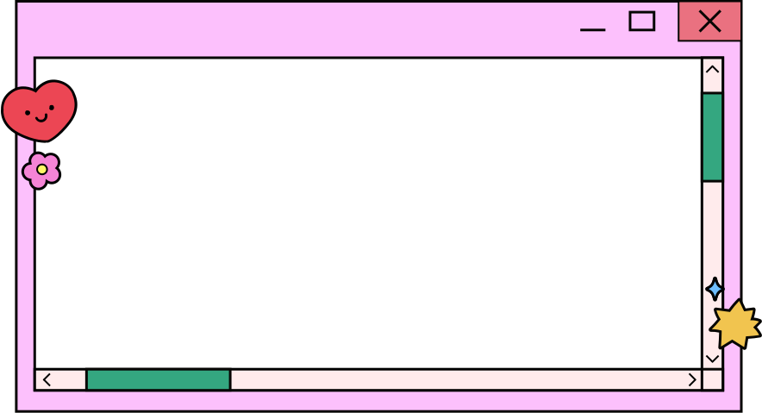


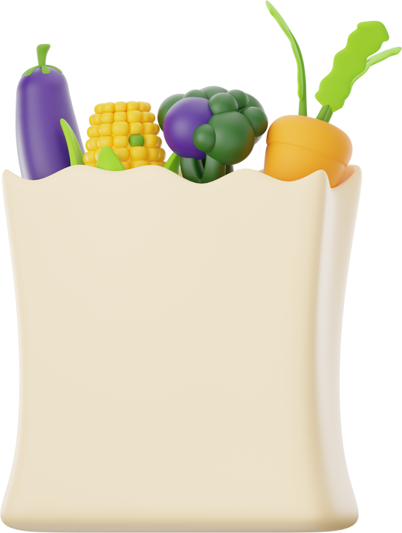



GROCERY STORE APP
Ahlam & Sabahat

Slide 2

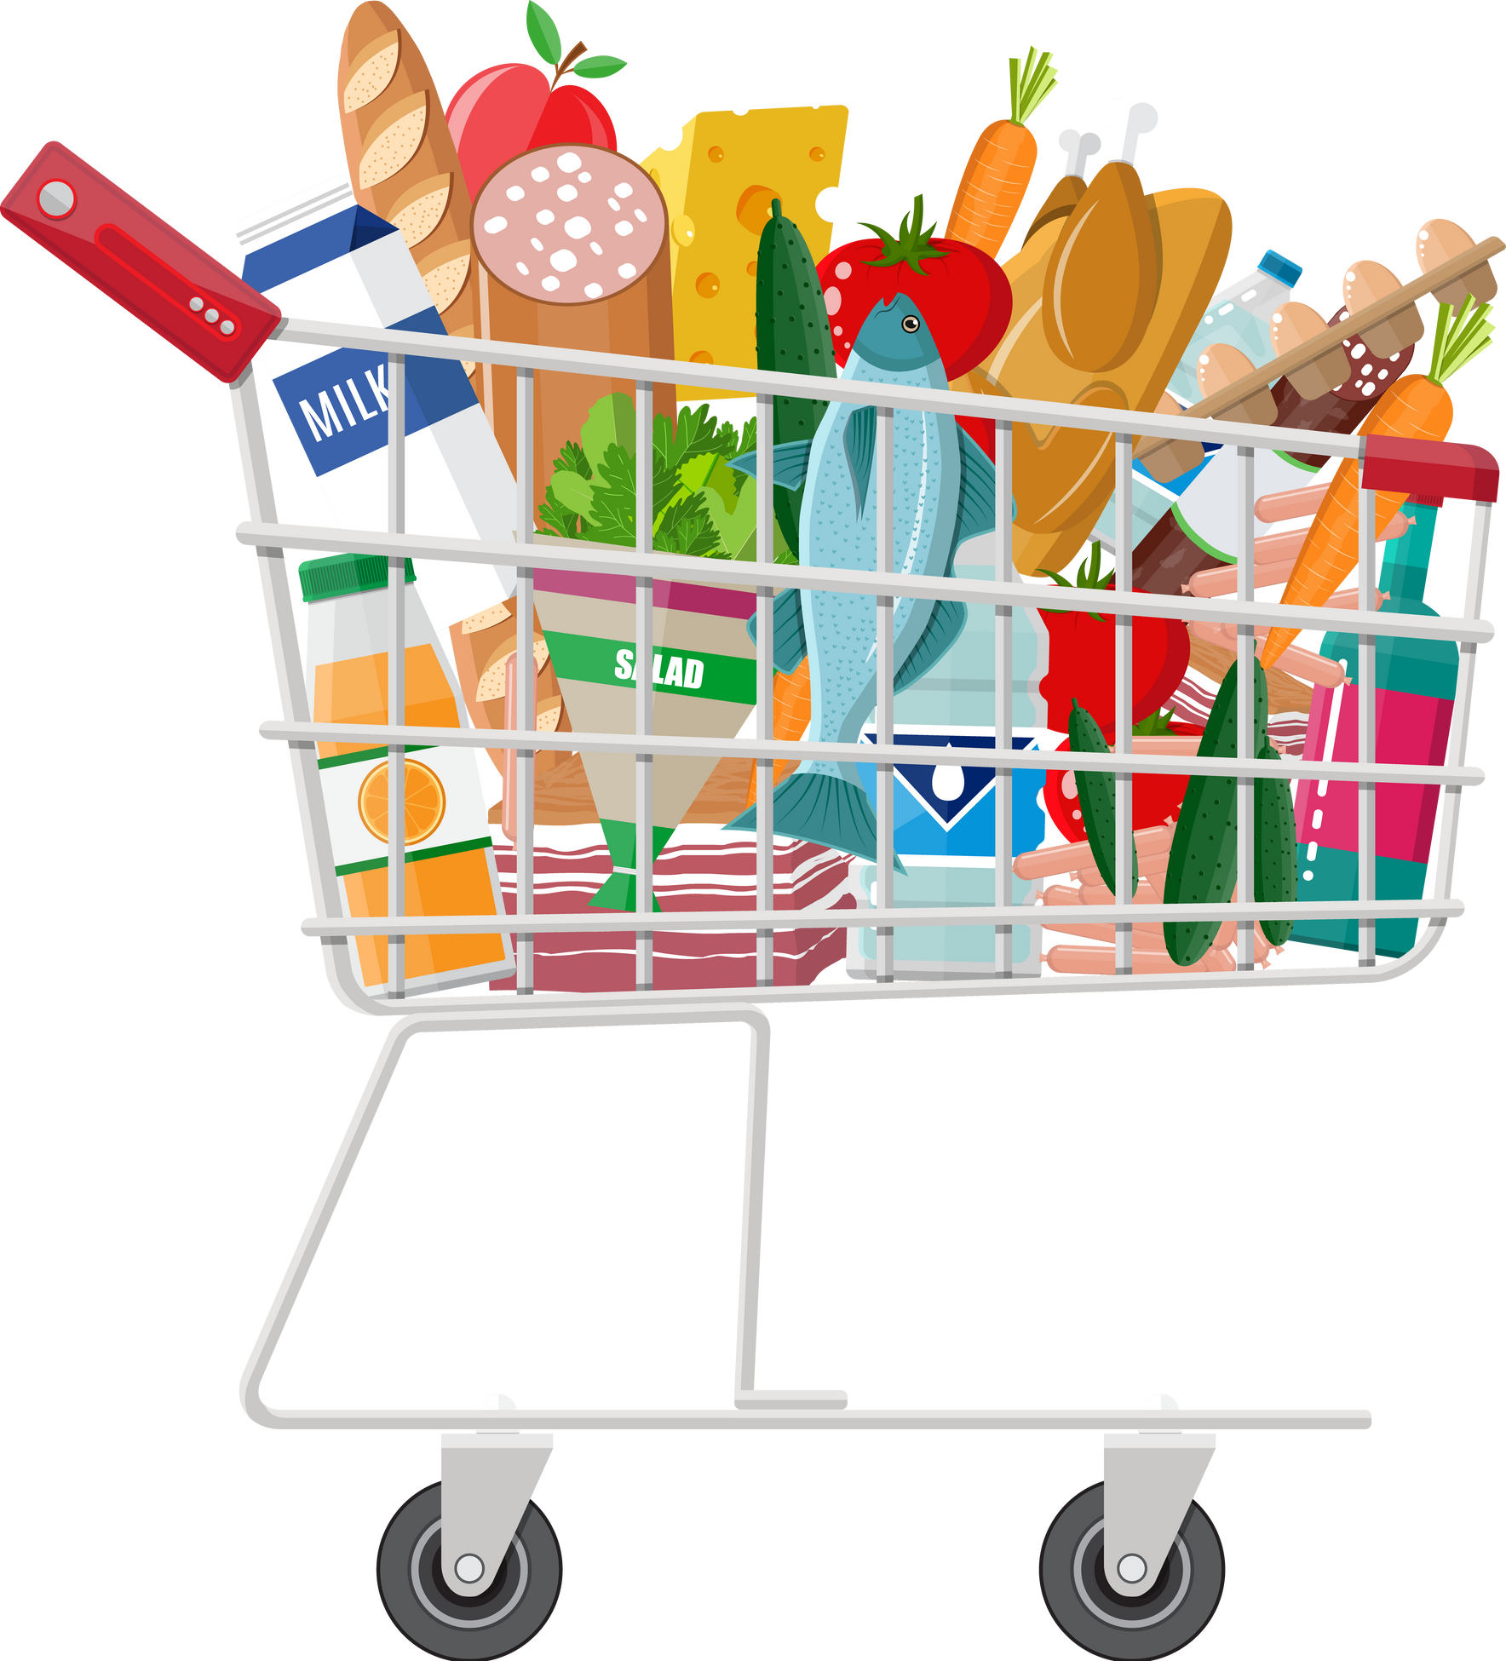
INTRODUCTION
Objective: To develop a user-friendly grocery shopping app that simplifies the way users browse, order, and purchase groceries.
Audience: Targeted towards individuals and families seeking convenience in managing their grocery shopping.

Slide 3


KEY FEATURES
CATEGORIES: ORGANIZES GROCERIES INTO CLEAR SECTIONS.
USER-FRIENDLY INTERFACE: EASY NAVIGATION AND INTUITIVE DESIGN.
SHOPPING CART AND CHECKOUT: SIMPLIFIED PURCHASING PROCESS.
PAYMENT OPTIONS: INCLUDES MULTIPLE SECURE PAYMENT METHODS (CREDIT CARDS, WALLETS, ETC.).

Slide 4

PAGES
SIGN UP
MY PROFILE
HOME
PAGE
SIGN IN
DYNAMIC SLIDESHOW
ADD TO CART
CHECKOUT

Slide 5
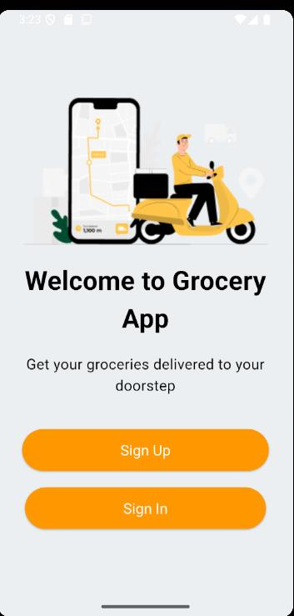
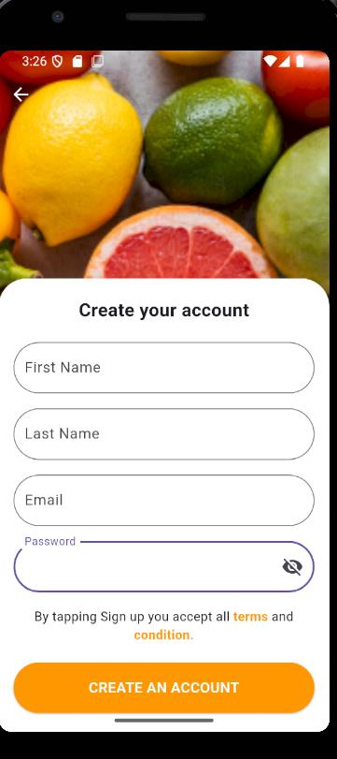
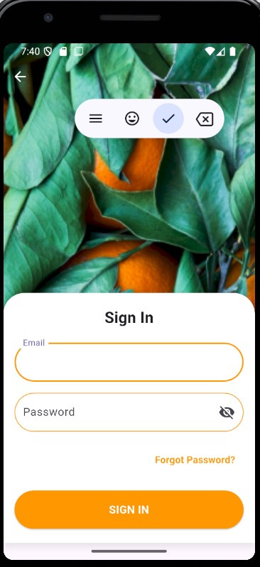


LOG IN/SIGN UP PAGE
SIGN UP PAGE
SIGN IN PAGE

Slide 6
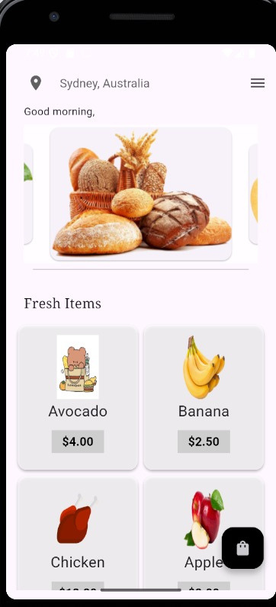
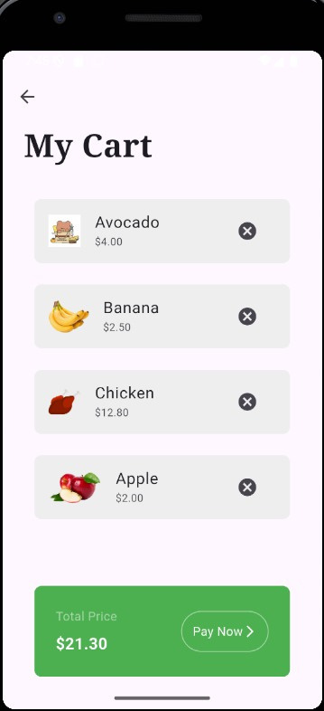
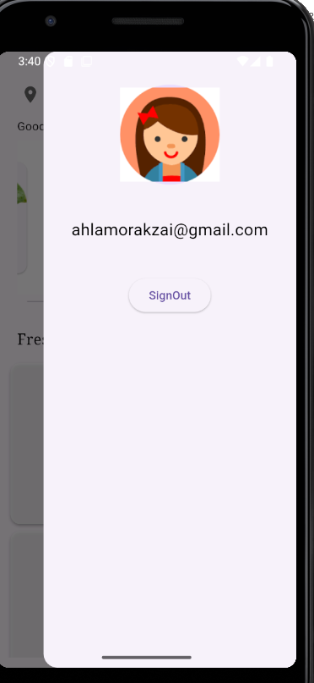
HOME PAGE
ITEMS ADDED TO CART
MY PROFILE

Slide 7
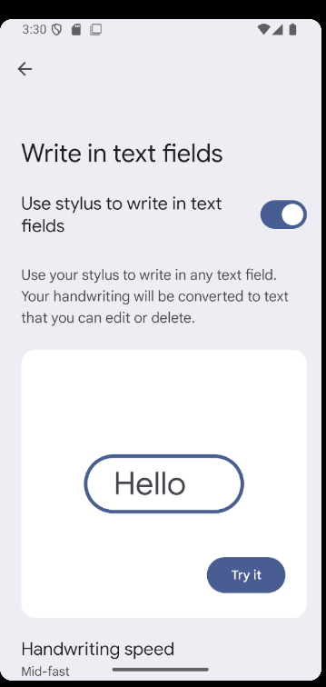
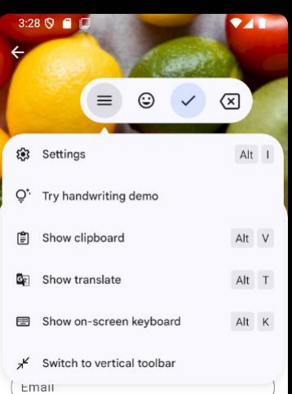
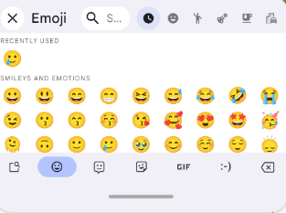

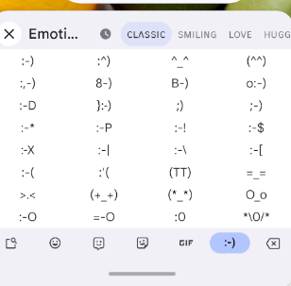
ADDITIONAL KEYBOARD FEATURES

Slide 8
OVERVIEW OF OOP IN OUR PROJECT
OBJECT-ORIENTED PROGRAMMING (OOP) IS A PARADIGM THAT STRUCTURES SOFTWARE DESIGN AROUND DATA, OR OBJECTS, RATHER THAN FUNCTIONS AND LOGIC.
IN YOUR GROCERY APP, OOP PRINCIPLES ENHANCE CODE MODULARITY, REUSABILITY, AND MAINTAINABILITY.

Slide 9
ENCAPSULATION:
EACH PAGE (E.G., HOMEPAGE, LOGIN PAGE, SETTINGS PAGE) IS ENCAPSULATED WITHIN ITS OWN CLASS, CONTAINING ITS SPECIFIC UI COMPONENTS AND LOGIC.
This design ensures that the internal workings of each page are hidden from other parts of the app, promoting modularity and security.

Slide 10
ABSTRACTION:
THE APP SIMPLIFIES COMPLEXITY BY USING REUSABLE WIDGETS AND BREAKING DOWN THE UI INTO SMALLER, MANAGEABLE COMPONENTS.
For instance, a generic Item class can represent various products, with specific details abstracted away in subclasses.

Slide 11
INHERITANCE
BY EXTENDING FLUTTER'S BASE CLASSES LIKE STATELESSWIDGET AND STATEFULWIDGET, THE APP'S WIDGETS INHERIT PROPERTIES AND METHODS, BUILDING UPON EXISTING FUNCTIONALITIES.
Custom widgets can be created by inheriting from these base classes, enabling the reuse of common behaviors.

Slide 12
POLYMORPHISM
THE APP UTILIZES POLYMORPHISM BY OVERRIDING METHODS TO PROVIDE SPECIFIC IMPLEMENTATIONS FOR DIFFERENT COMPONENTS, ENABLING THEM TO BE USED INTERCHANGEABLY THROUGH A COMMON INTERFACE.
For example, different item types (e.g., GroceryItem, ElectronicItem) can have their own display methods, but can be managed through a common Item interface

Slide 13
BENIFITS OF OOP IN GROCERY APP
MODULARITY:
Each component of the app is divided into distinct classes, making the codebase easier to manage and understand.
Reusability:
Classes and methods can be reused across different parts of the app, reducing redundancy.
Maintainability:
The structured approach of OOP makes it easier to update and maintain the app as it evolves.
Scalability:
New features can be added with minimal impact on existing code, facilitating future enhancements.

Slide 14
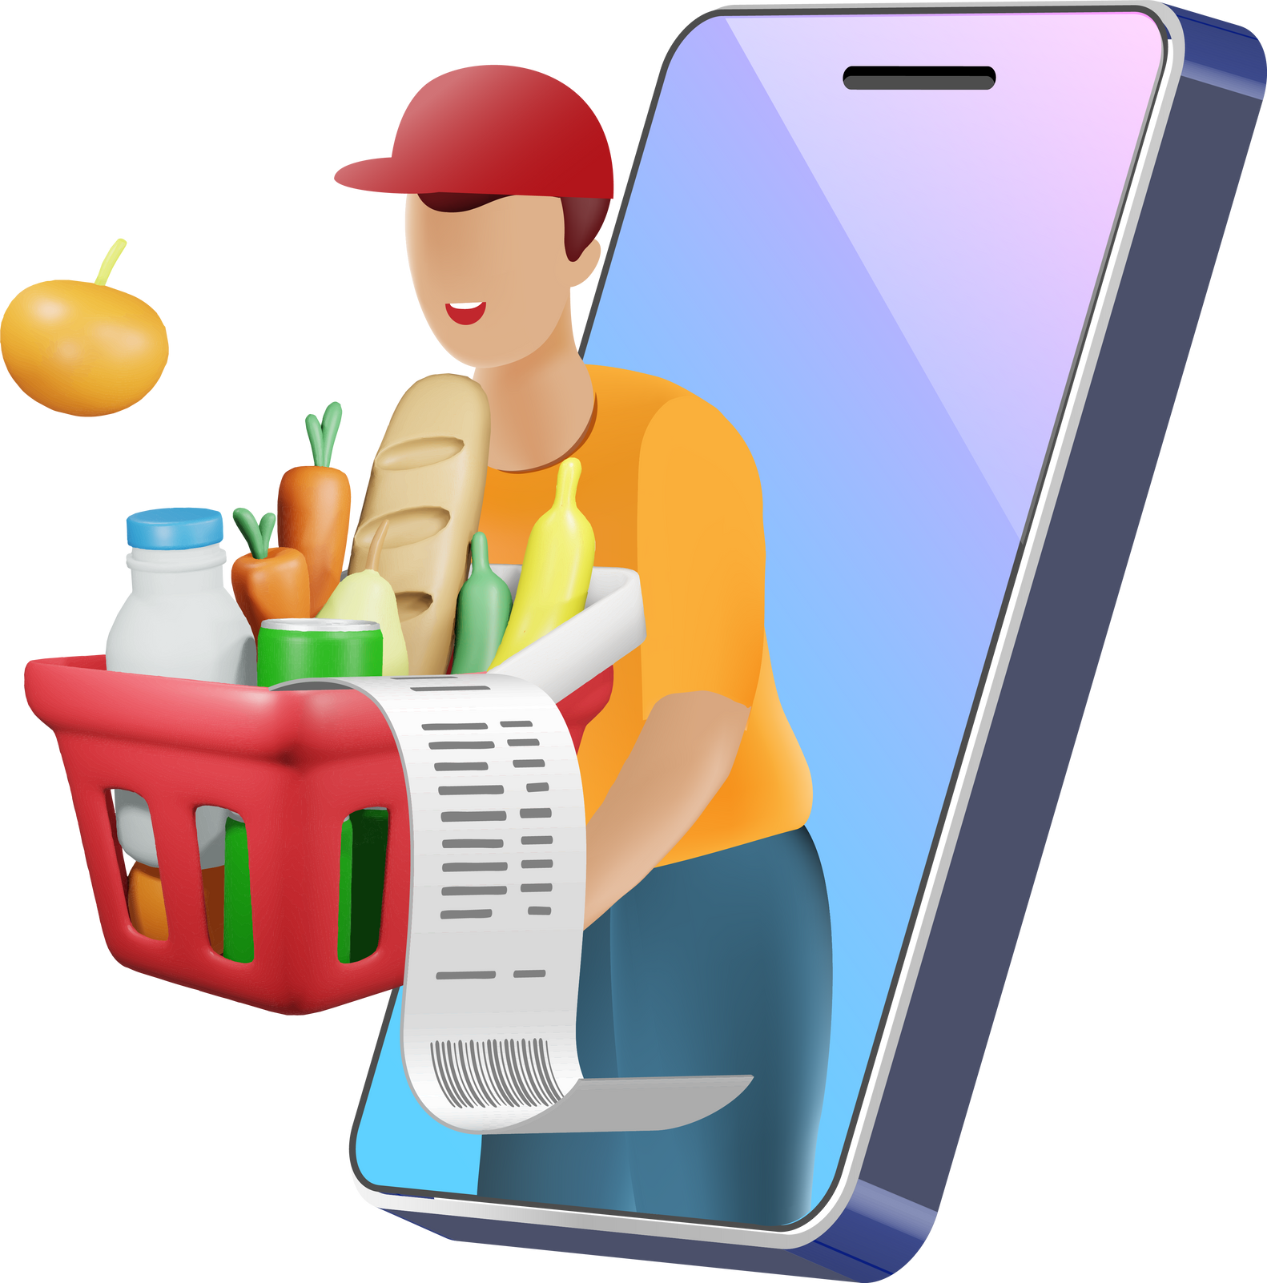




THANK YOU!

